Slide 1
Movies Dshboard from hollywood movies sample
File created on: 4/5/2025 1:43:29 PM

Slide 2
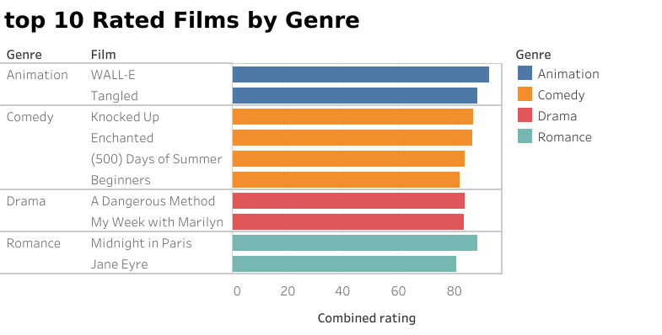

Slide 3
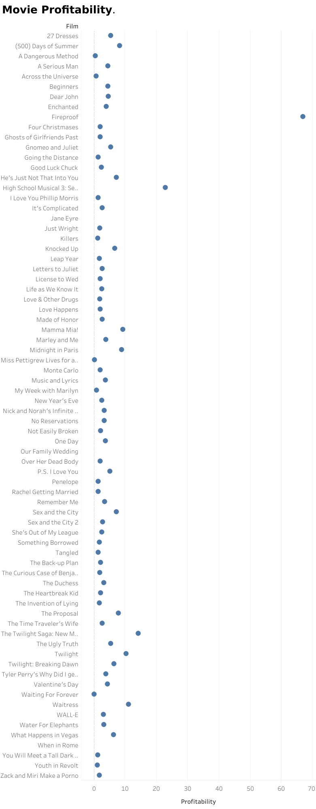

Slide 4
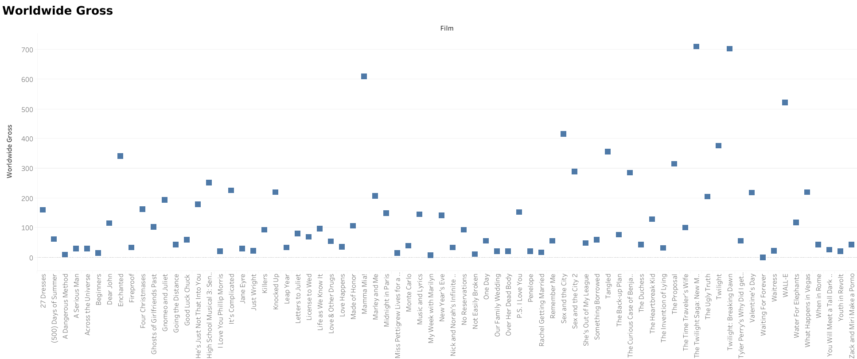

Slide 5
